Slide 1
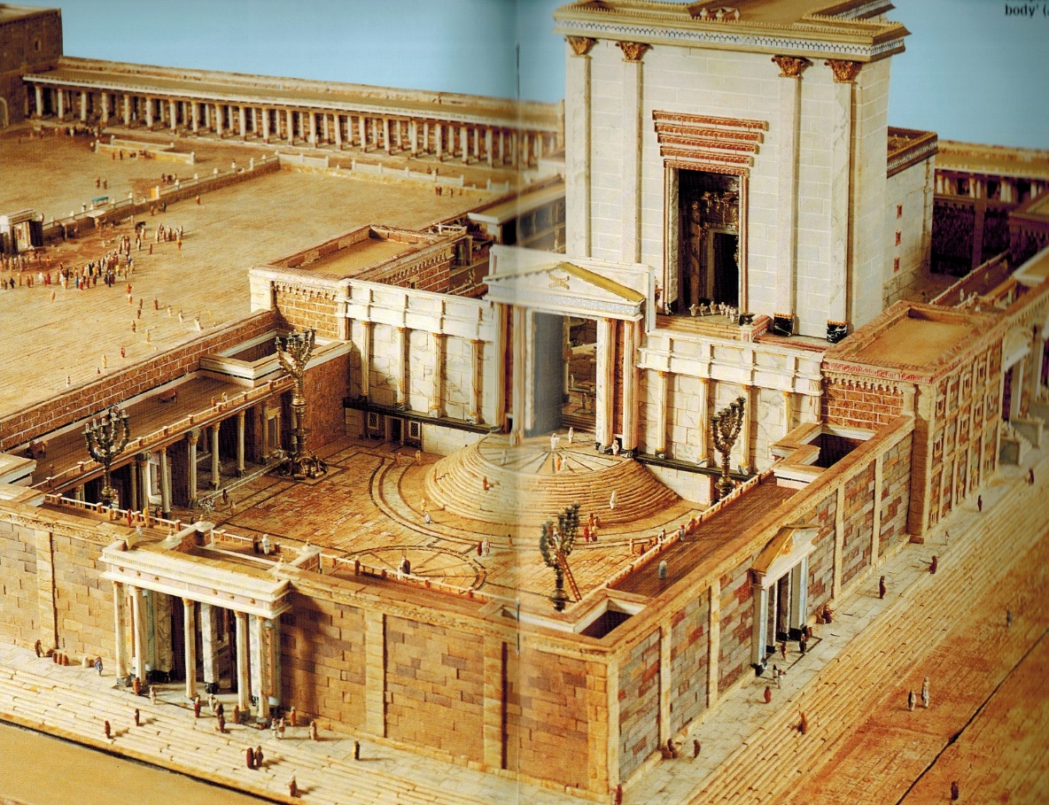
John 8.12-30
Backhouse: The Jerusalem Temple

Slide 2
John 8.12 NET: Then Jesus spoke out again, ‘I am the light of the world. The one who follows me will never walk in darkness, but will have the light of life.’

Slide 3
John 8.12 NET: Then Jesus spoke out again, ‘I am the light of the world. The one who follows me will never walk in darkness, but will have the light of life.’
Psalms 27.1 NIV: “The LORD is my light and my salvation-- whom shall I fear?”
Psalms 119.105 HCSB: “Your word is a lamp for my feet and a light on my path.”

Slide 4
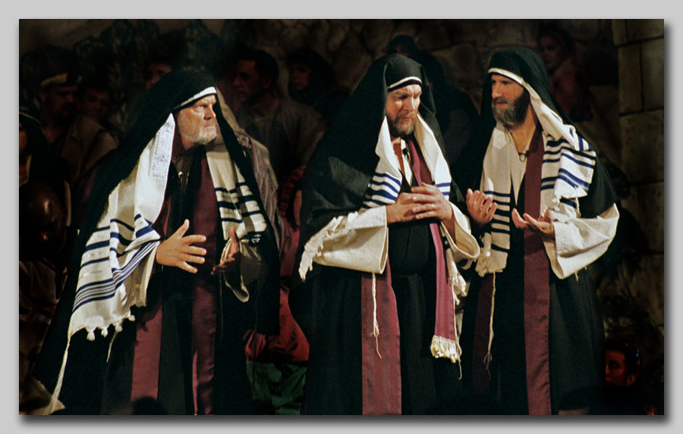
John 8.13: So the Pharisees objected, “You testify about yourself; your testimony is not true!”
Deuteronomy 19.15 NIV: One witness is not enough to convict anyone accused of any crime or offense they may have committed. A matter must be established by the testimony of two or three witnesses.

Slide 5
John 8.14-18: Jesus answered, “Even if I testify about myself, my testimony is true, because I know where I came from and where I am going. But you people do not know where I came from or where I am going. You people judge by outward appearances; I do not judge anyone. But if I judge, my evaluation is accurate, because I am not alone when I judge, but I and the Father who sent me do so together. It is written in your law that the testimony of two men is true. I testify about myself and the Father who sent me testifies about me.”
Matson:
Life in the Holy Land
© 2009 Todd Bolen

Slide 6
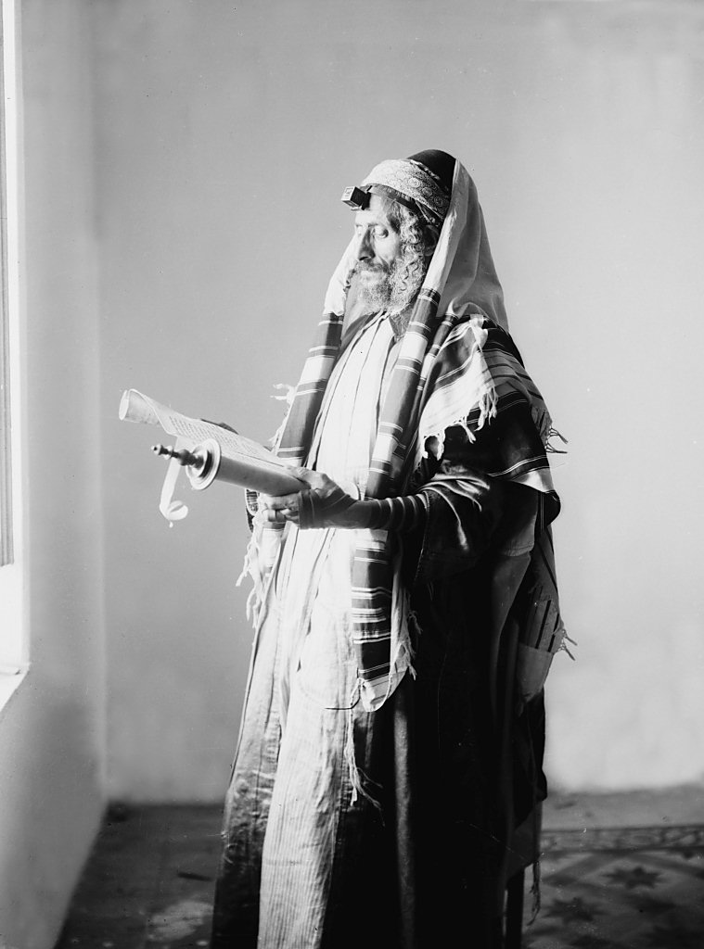
John 8.19-20: Then they began asking him, “Who is your father?” Jesus answered, “You do not know either me or my Father. If you knew me you would know my Father too.” (Jesus spoke these words near the offering box while he was teaching in the temple courts. No one seized him because his time had not yet come.)
Matson: Life in the Holy Land
© 2009 Todd Bolen

Slide 7
John 8.21-24: Then Jesus said to them again, “I am going away, and you will look for me but will die in your sin. Where I am going you cannot come.” So the Jewish leaders began to say, “Perhaps he is going to kill himself, because he says, ‘Where I am going you cannot come.’” Jesus replied, "You people are from below; I am from above. You people are from this world; I am not from this world. Thus I told you that you will die in your sins. For unless you believe that I am he, you will die in your sins.”

Slide 8
Failure
to obey
commands
imputed sin [guilt of human race]
inherited sin [corrupted nature]
acts of sin [acts against God]
Need for salvation
Faith
in
promises
Faith in
gospel
promise
of salvation
=
Gift of salvation

Slide 9
John 8.25-27 So they said to him, “Who are you?” Jesus replied, “What I have told you from the beginning. I have many things to say and to judge about you, but the Father who sent me is truthful, and the things I have heard from him I speak to the world.” (They did not understand that he was telling them about his Father.)

Slide 10
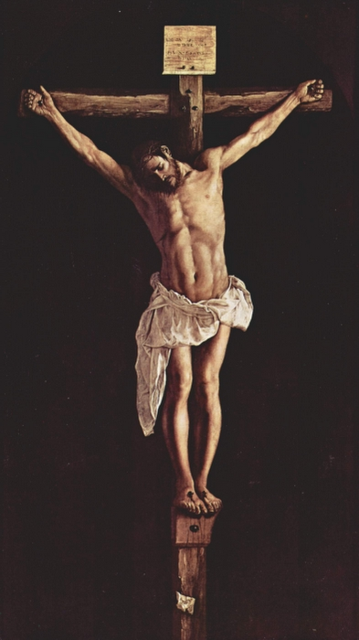
John 8.28-30: Then Jesus said, “When you lift up the Son of Man, then you will know that I am he, and I do nothing on my own initiative, but I speak just what the Father taught me. And the one who sent me is with me. He has not left me alone, because I always do those things that please him.” While he was saying these things, many people believed in him.
Francisco Zurbaran / Vanderbilt.edu

Slide 11
John 8.24: “For unless you believe that I am he,
you will die in your sins.”
John 8.28: “When you lift up the Son of Man, then you will know that I am he…”
John 8.58: “I tell you the solemn truth, before Abraham came into existence, I am!”
ἐγώ εἰμι
ἐγώ εἰμι
ἐγώ εἰμι

Slide 12
John 8.28-30: Then Jesus said, “When you lift up the Son of Man, then you will know that I am he, and I do nothing on my own initiative, but I speak just what the Father taught me. And the one who sent me is with me. He has not left me alone, because I always do those things that please him.” While he was saying these things, many people believed in him.

Slide 13
John 8.12 NET: Then Jesus spoke out again, ‘I am the light of the world. The one who follows me will never walk in darkness, but will have the light of life.’

